Slide 1
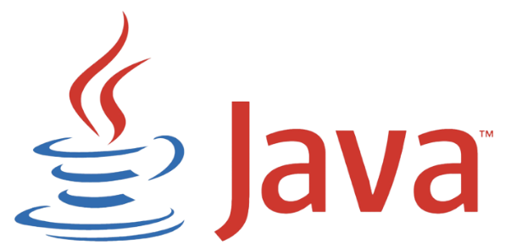
Grupo 04
Alberto Saboya – Anabella aceto – david rodríguez

Slide 2

Its origins...
It was launched in June 1991.
In 1996 Sun Microsystems the first public implementation of Java 1.0
In 1998, Java 2 was released and it added multiple configurations designed for different types of platforms.
In 2006 is launched as free and open-source software.
In 2009, Oracle Corporation acquared Sun Microsystems.

Slide 3
OJBECT ORIENTATION IN JAVA
Java is an object-oriented programming language.
Based on the concept of "objects" encapsulating data and behavior
Java is a widely used, object-oriented programming language
Key Aspects:
Everything in Java is considered an object
Objects are instances of classes, serving as blueprints
Classes define properties (attributes) and behaviors (methods)

Slide 4
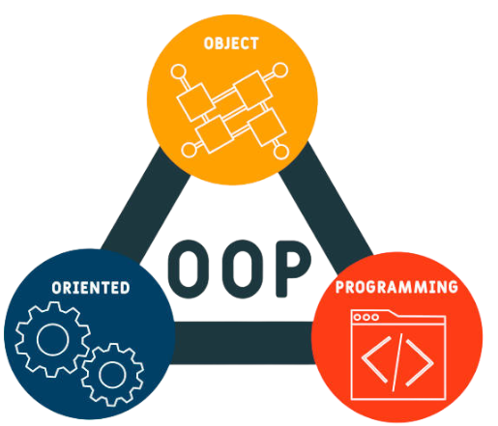
Principles of Object Orientation in Java
Encapsulation.
Inheritance.
Polymorphism.
Abstraction.
Association and Composition

Slide 5

Memory management and garbaje collection
Automatic Memory Management: Java uses a garbage collector to automatically manage memory.

Slide 6

Extensive Standard Library
Java comes with an extensive standard library that provides classes and methods for various tasks, from string manipulation to network operations.

Slide 7
JAVA EE and se platform

Slide 8
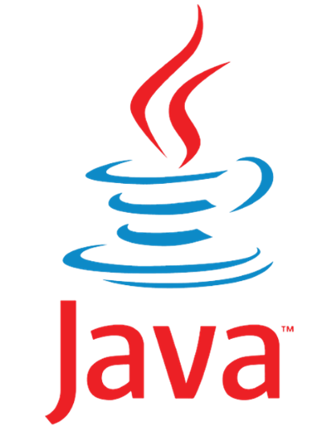
Java curiosities
Origin of the Name: Java got its name from coffee.
It was designed to programm smart TVs

